Slide 1
Chapter 1: DNA

Slide 2
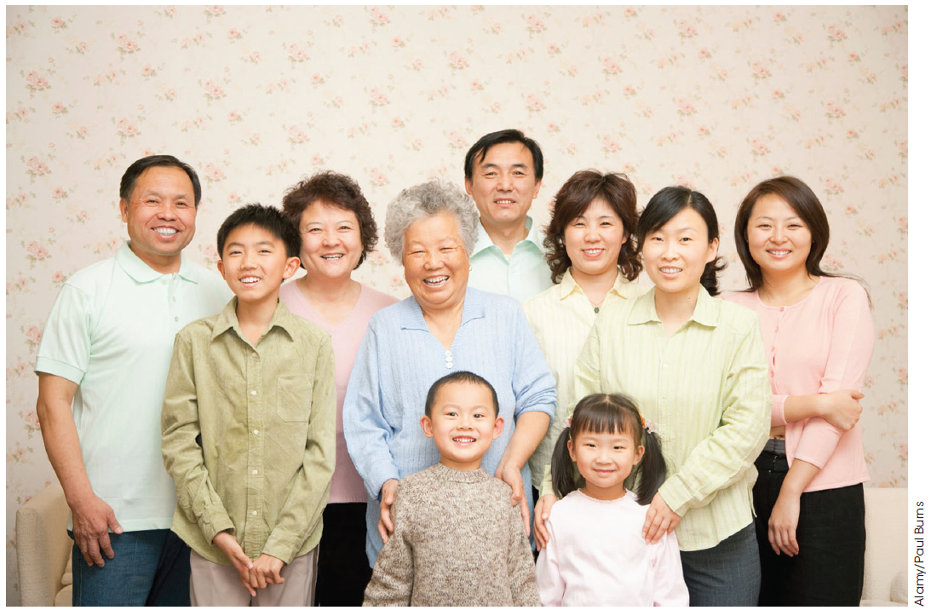
DNA is the hereditary material
Figure 1.1
Similarities can be seen between closely related individuals.
Genes are responsible for this.
The genetic information that is transmitted from parents to their children is carried within DNA.
DNA contains genes, which determine the traits of an individual. The study of how these are passed from one generation to another is called heredity.

Slide 3
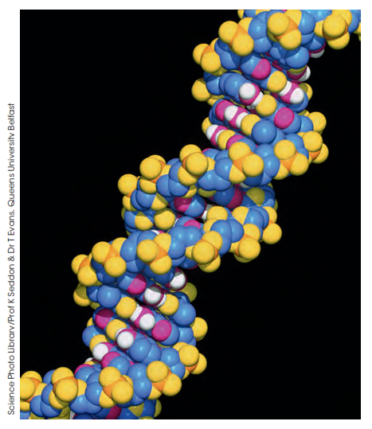
Structure of DNA
Figure 1.2
A space-filling model of DNA which contains carbon (blue), oxygen (yellow), hydrogen (some shown in white), phosphorous (orange) and nitrogen (pink)
DNA is the same material, with the same structure, in all species.
This means it appeared early in the evolution of species and stayed the same as species evolved.
DNA is a very efficient, biologically successful, way of carrying complex information such as that required to build organisms.

Slide 4
New concepts: from DNA to traits
Structure of DNA
DNA is a linear molecule that contains units called genes.
A gene contains the instructions for a gene product, commonly a protein.
The instructions contained within a gene are read by cellular machinery.
When the product (e.g. protein) of a gene is made, it is expressed.
Traits are characteristics that are determined by the expression of genes.

Slide 5
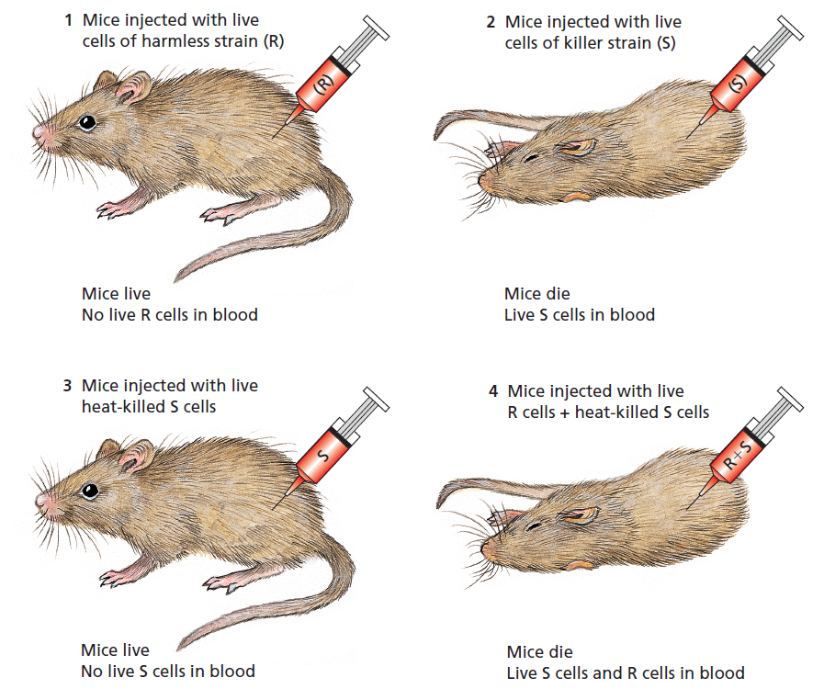
Early evidence of DNA
Structure of DNA
Figure 1.3
Summary of the results from Griffith’s
experiments with a harmless (R) strain and a disease-causing (S)
strain of Streptococcus pneumoniae
In this experiment, heat-resistant genetic material (DNA) was transferred from S cells to R cells, giving them the genes whose products proved deadly for the mice.

Slide 6
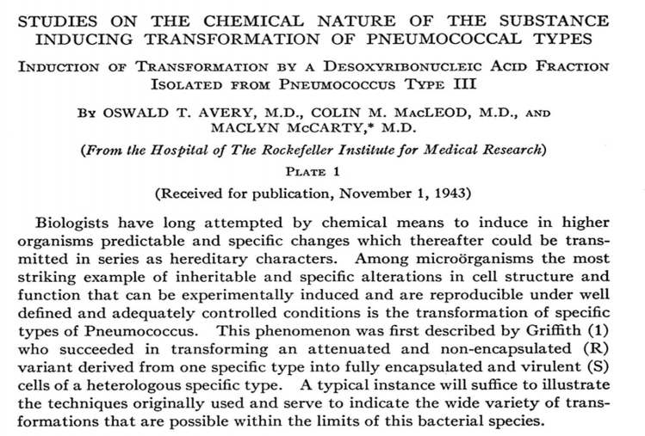
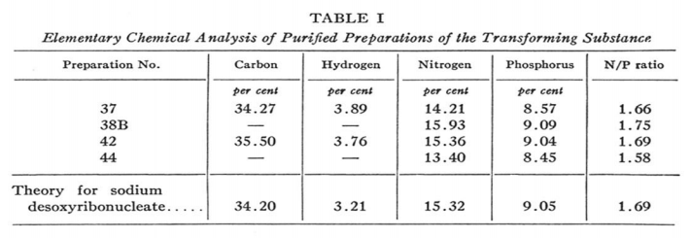
Timeline for the discovery of DNA
Structure of DNA
1928
Frederick Griffith discovered heat-resistant genetic material transferred between bacterial strains.
1944
Oswald Avery repeated Griffith’s and showed that DNA, not proteins, lipids or carbohydrates, was the genetic material.
http://www.nature.com/nature/dna50/macLeodmccarty.pdf

Slide 7
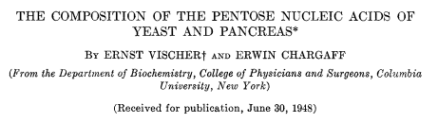
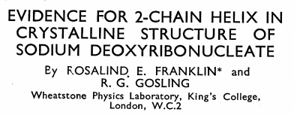

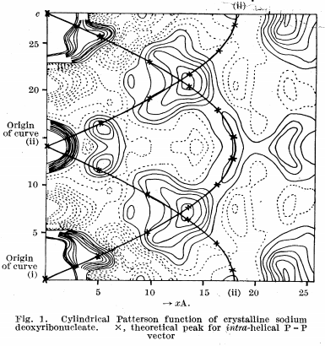
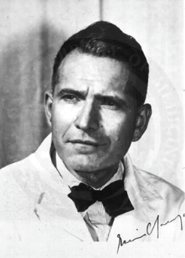
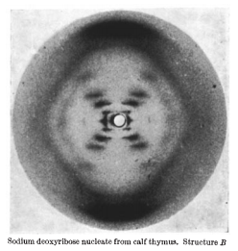
Timeline for the discovery of DNA
Structure of DNA
1948
Erwin Chargaff used chromatography to discover the ratio of nucleotides within DNA.
1950
Maurice Wilkins and Ray Gosling obtained X-ray diffraction patterns from DNA. Alec Stokes suggested DNA was helical in nature from these patterns.
1952
Rosalind Franklin in Maurice Wilkins’ lab obtained clear
X-ray diffraction patterns from DNA, a task that had been very difficult.
M. H. F. Wilkins, A. R. Stokes, H. R. Wilson
Nature. April 2, 1953
National Library of Medicine
Nature 1953 (172):156-157
Erwin Chargaff

Slide 8
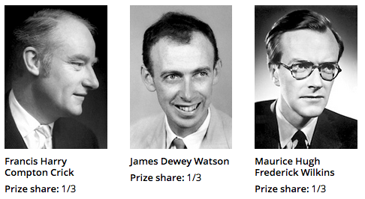
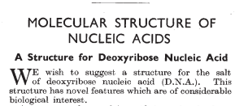
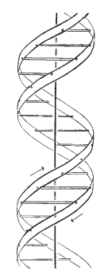
Timeline for the discovery of DNA
Structure of DNA
1953
A flurry of scientific publication occurred to describe the structure of DNA. This included Watson and Crick’s description of the DNA double helix (below), enabled by the discoveries of Wilkins, Franklin and many others.
1962
The Nobel Prize in Physiology or Medicine was awarded to Watson, Crick and Wilkins for their discoveries relating to the structure of DNA.
Nature 1953 (177):737-738

Slide 9
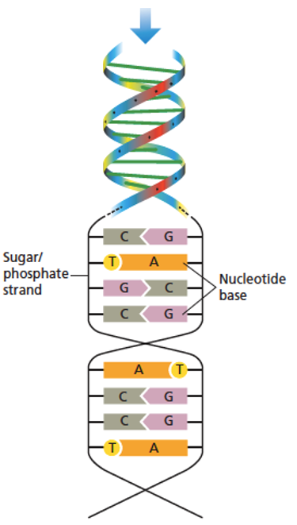
Structure of DNA
DNA is composed of two helical strands winding around a central axis.
The individual subunits that make the strands are nucleotides, which have a sugar phosphate backbone and a base facing the centre of the double helix.
Figure 1.7

Slide 10
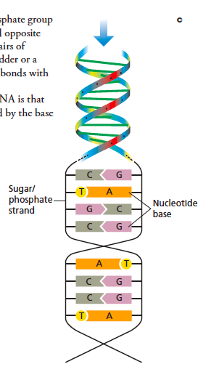
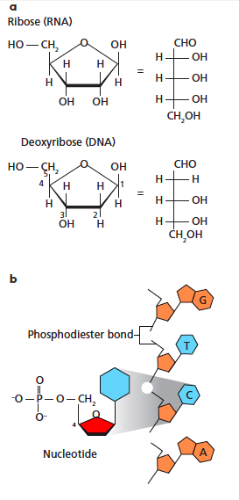
Structure of DNA
The phosphate groups that, with the sugar ring (red), form the DNA backbone, give DNA an overall negative charge.
Nucleotides also contain a a nitrogenous base (blue), of which there are four possibilities:
called A, T, C and G.
Figure 1.7

Slide 11
Structure of DNA
The DNA sugar ring is called deoxyribose.
In ribonucleic acid (RNA), the sugar ring is ribose.
Figure 1.7

Slide 12
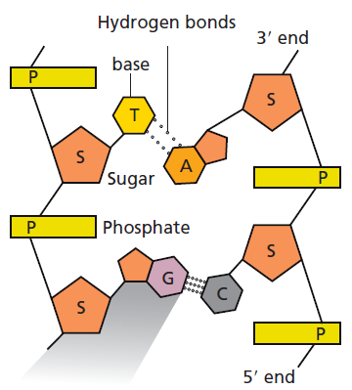
Structure of DNA
The four nucleotides in DNA are:
A – adenine
T – thymine
G – guanine
C – cytosine
In DNA,
A always pairs with T
G always pairs with C
This is Chargaff’s rule.
Nitrogenous bases of opposite DNA strands are held together by hydrogen bonds.
A and T have two hydrogen bonds.
G and C form three bonds.
Figure 1.7
DNA has directionality:
the phosphate is at the 5’ end
the sugar is at the 3’ end
DNA is ‘read’ from 5’ to 3’

Slide 13
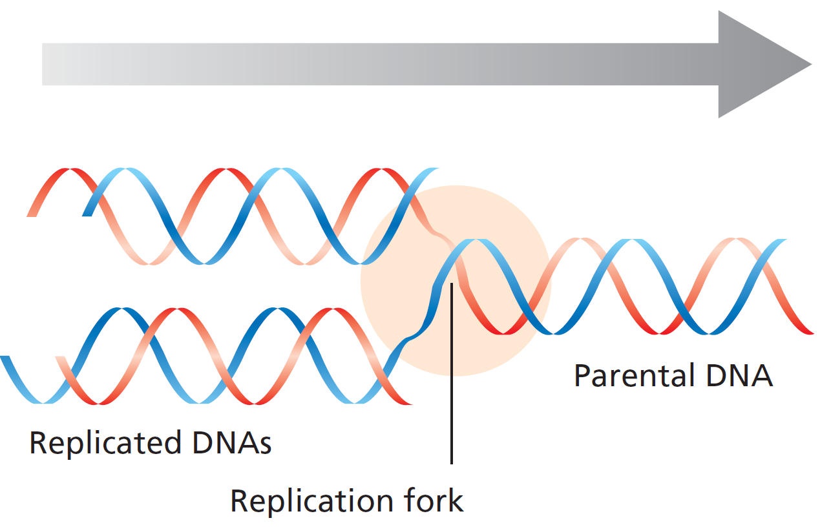
DNA replication
Structure of DNA
DNA contains two opposing strands.
One is the template strand.
This the strand that contains the genetic information.
The other is the complimentary strand.
DNA replication requires the two strands to separate at a replication fork, at which the replication machinery access the DNA.
Figure 1.8

Slide 14
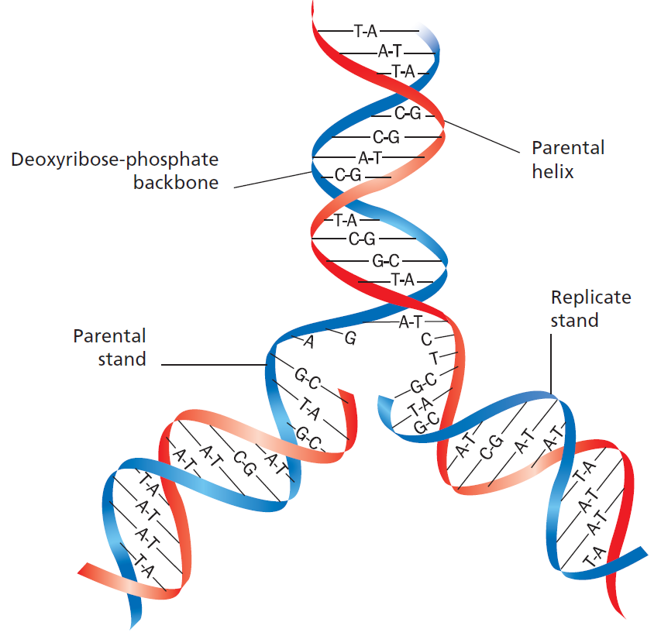
DNA replication
Structure of DNA
During DNA replication, the specific pairing of A with T and G with C ensures that DNA is replicated accurately.
When DNA is replicated, one strand in the ‘daughter’ DNA molecule is always from the parental DNA and the other strand is newly-formed.
Figure 1.9

Slide 15
Genomics – some definitions
Structure of DNA
All of an organism’s genetic information is collectively termed its genome.
Genomics is the study of organisms’ genomes.
Proteomics is the study of all of an organism or cell’s proteins.
Bioinformatics uses algorithms to sort through large amounts of biological information; e.g. DNA sequences acquired in genomic studies.

Slide 16
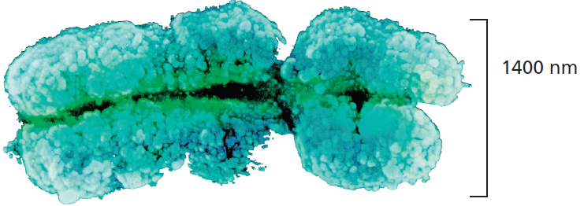
DNA is organised into chromosomes
Organisation of DNA
Each DNA molecule is a long fibre called a chromosome; at certain times in a cell’s life it resembles an X-shaped structure.
DNA is found associated with proteins that help to package it. DNA and its associated proteins are called chromatin.
Figure 1.11

Slide 17
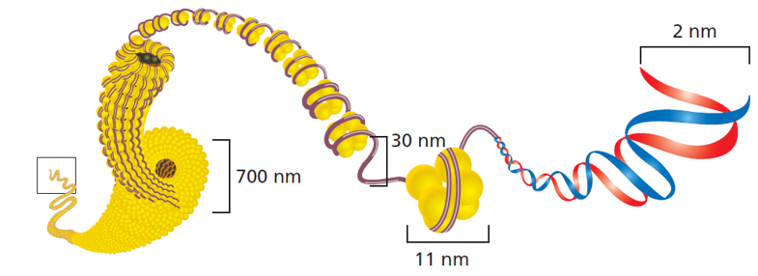
Structure of chromosomes
Organisation of DNA
The main proteins that help to package DNA are called histones.
A group of eight histones is called a nucleosome (yellow).
DNA is wound around nucleosomes like beads on a chain.
When the nucleosome ‘beads’ are loose, the chromatin is ‘open’ and is accessible to be read or replicated.
When the nucleosomes and DNA are tightly packed, the chromatin is ‘closed’.
Figure 1.11

Slide 18
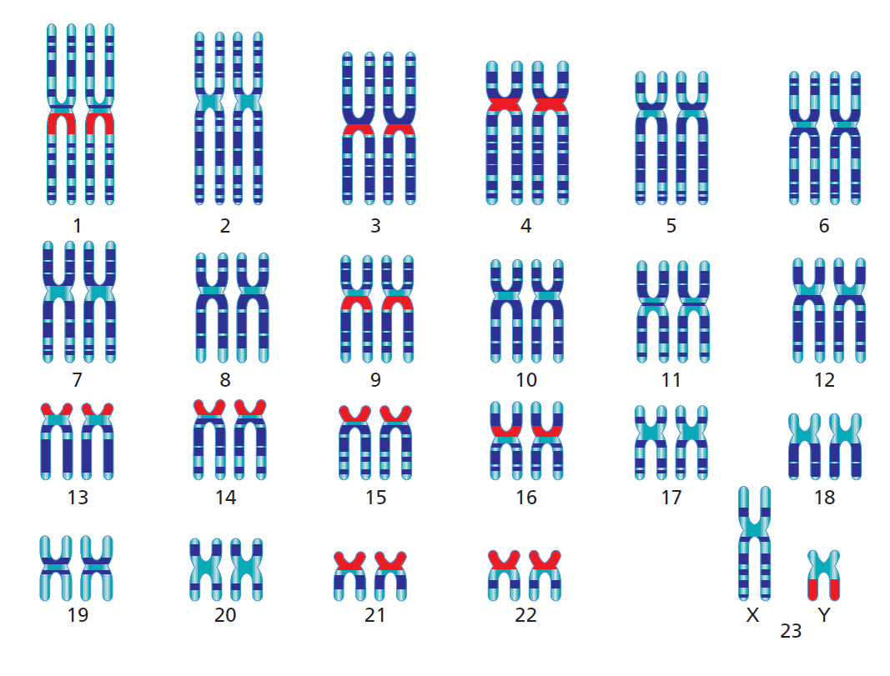
Chromosomes
Organisation of DNA
In human body (somatic) cells, there are 23 pairs of chromosomes; when these are paired and ordered they can be shown as a karyotype.
Each pair of chromosomes contains one paternal and one maternal chromosome.
Matched pairs of chromosomes are called autosomes and are homologous.
One pair of chromosomes is the sex chromosomes or heterozomes, termed X and Y – pairs can be XX (homologous) or XY (heterologous).
Figure 1.12

Slide 19
Ploidy
Organisation of DNA
Ploidy is the number of pairs of chromosomes in a cell.
In humans, the haploid number (n) is 23 so there are 23 pairs of chromosomes in a body cell.
The diploid number for a human body cell is:
(2n) = 46, i.e. 2 × 23 pairs of chromosomes.

Slide 20
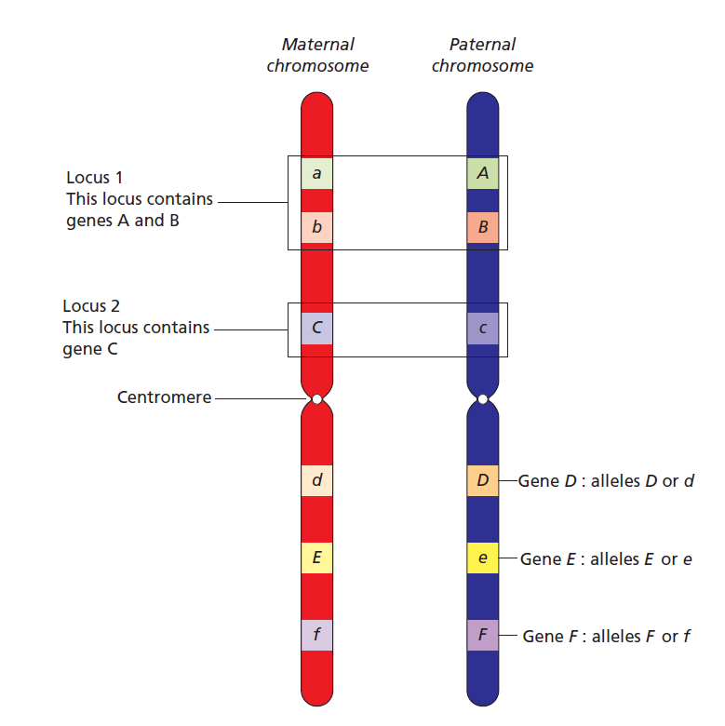
Genetic loci
Organisation of DNA
A genetic location is called a locus.
A locus is the position of a gene, a cluster of genes or even a single nucleotide on a chromosome.
Since there are two of each chromosome in a somatic cell, there are two copies of each gene.
Individual gene copies are called alleles and can be given names such as D and d depending on the allele’s characteristics.
Figure 1.13

Slide 21
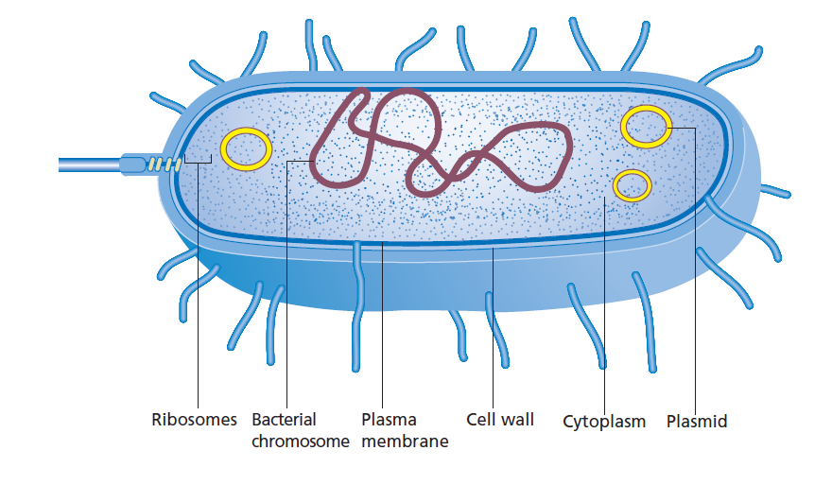
Prokaryotic chromosomes
Organisation of DNA
Prokaryotic chromosomes are usually single circular molecules and prokaryotes are therefore haploid.
Since prokaryotes do not have nuclei, their chromosomes are present in the cytoplasm in regions known as the nucleoid and can be attached to the plasma membrane.
Small circular DNA molecules called plasmids may float freely in the cytoplasm.
Plasmids often carry non-essential genes and replicate independently of the chromosome.
Figure 1.14

Slide 22
New terms – cell division
Cell division
Division of somatic cells occurs via mitosis.
Cell division that produces gametes occurs via meiosis.
Cytokinesis describes division of the cytoplasmic contents.
Binary fission is division of prokaryotic cells.

Slide 23
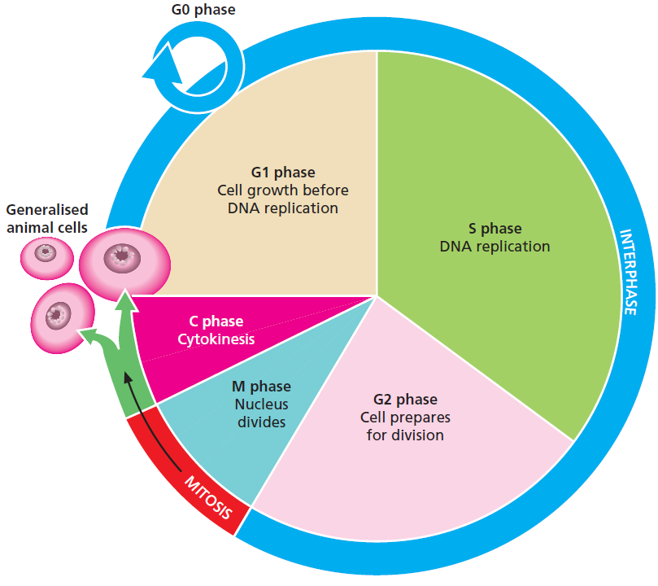
The cell cycle
Cell division
G1 phase is a period of cell growth.
Cells spend much of their time in G1.
In S phase, DNA replication occurs.
At the end of S phase, the cell has
double its normal DNA content.
Following DNA replication, the cell
checks the new chromosomes for
errors and makes other preparations
for division in G2 phase.
M phase is the division of the chromosomes
by the process of mitosis.
C phase is the division of the cytoplasmic
contents by the process of cytokinesis.
Figure 1.15

Slide 24
Stepping outside the cell cycle
Cell division
G0 phase occurs when the cell has
exited the cell cycle and is not preparing
to undergo division.
Cells that have terminally
differentiated (i.e. reached their
most specialised, final form such
as a nerve cell) are usually in
G0 phase.
Cells in G0 phase can sometimes
re-enter the cell cycle if they receive the
correct stimuli.
Figure 1.15

Slide 25
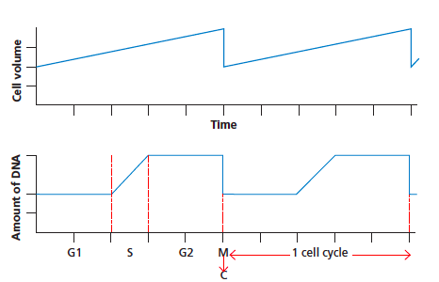
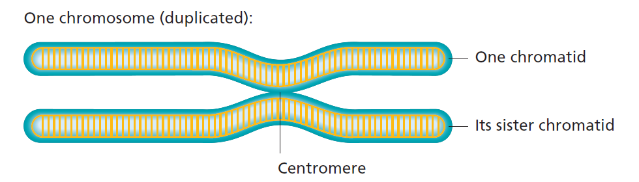

The cellular volume and DNA content changes during the cell cycle
Cell division
Figure 1.16
& 1.18
Cell division
Cell division
Mother cell
Each daughter cell
One of each chromosome
Two copies of each chromosome

Slide 26
Phases of the cell cycle
Cell division
Interphase – Includes G0, G1, S and G2 phases.
Chromosomes are not condensed and are therefore not visible.
Prophase – Chromatin condenses and chromosomes become visible as
X-shaped structures joined in the centre by the centromere.
Microtubule spindle fibres begin to form, originating at two centrioles.
Metaphase – Chromosomes line up along the equator of the cell,
called the metaphase plate.
Anaphase – Spindle fibres attach to centromeres and pull apart sister
chromatids as they contract towards the centrioles, at opposite
poles of the cell.
Telophase – Separated chromatids are now called chromosomes.
These de-condense and new nuclear membranes are formed.

Slide 27
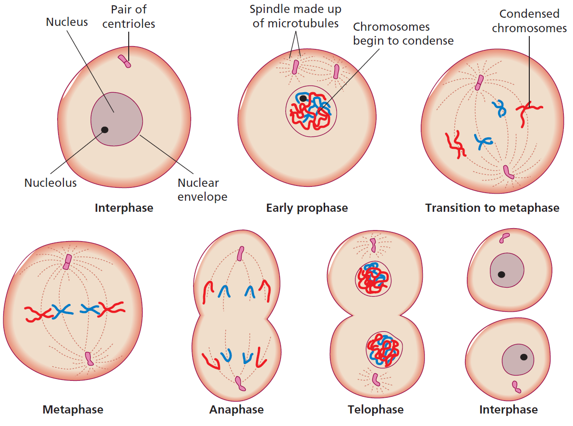
Phases of the cell cycle
Cell division
Figure 1.17

Slide 28
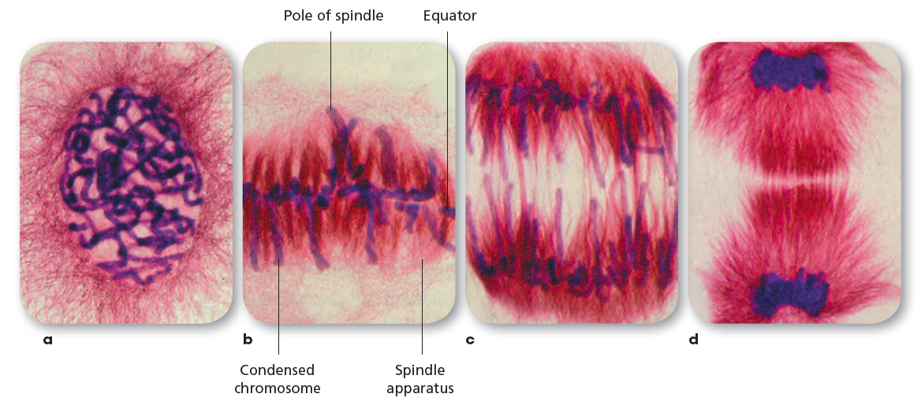
Phases of mitosis are often clearly visible under a microscope
Cell division
Prophase
Metaphase
Anaphase
Telophase

Slide 29
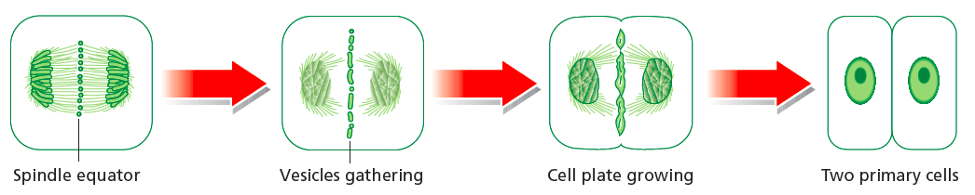
Cytokinesis
Cell division
Figure 1.19
Cytokinesis is division of the cytoplasmic contents in order for the cell to divide.
In plant cells, cytokinesis also involves formation of a new cell wall.
Vesicles containing cell wall components cluster at the cell’s equator.
This is called the cell plate and grows to form the new cell walls.

Slide 30
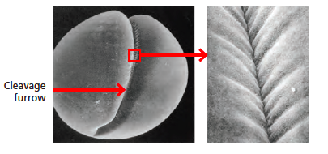
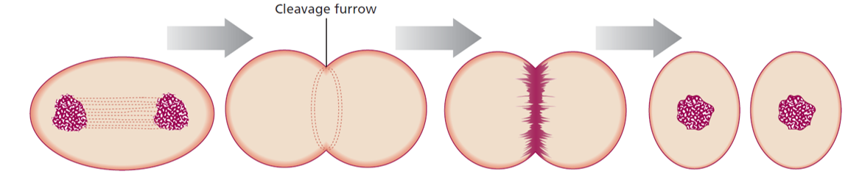
Cytokinesis in animal cells involves formation of a cleavage furrow
Cell division
Figure 1.21
Mitosis
Formation of new
plasma membrane
New membrane
constricts to
cleave cell
Two daughter
cells
are formed

Slide 31
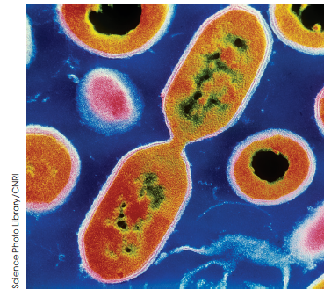
Binary fission
Cell division
Binary fission is cell division of prokaryotic cells.
This includes DNA replication, chromosome
segregation and cytokinesis.
Once replicated, the two chromosomes attach
to different parts of the membrane are segregated
as the cell is separated by cytokinesis.
In eukaryotic cells mitochondria and chloroplasts
divide by binary fission.
Figure 1.22

Slide 32
Meiosis – formation of haploid gametes
Cell division
Meiosis has two major phases:
Meiosis I divides 4n germ cells (primary gametocytes)
to form 2n intermediate cells (secondary gametocytes).
Meiosis II divides 2n cells to form n (haploid) gametes.
Meiosis II
Meiosis I
n
2n
n
2n
4n
n
2n
n

Slide 33
Meiosis I
Cell division
Prophase I – Chromosomes condense and in synapsis, homologous
chromosomes pair up as bivalents
Metaphase I – The nuclear envelope dissolves and bivalents assemble at the
cell’s equator
Anaphase I – Disjunction is the separation of bivalents when maternal and
paternal chromosomes move to opposite poles of the cell
Telophase I – Spindle fibres that have segregated the bivalents dissolve, the
chromosomes de-condense and cytokinesis occurs
A brief period of interphase occurs before the start of meiosis II.

Slide 34
Meiosis II
Cell division
Prophase II – A new spindle forms at right angles to the first
Metaphase II – Chromosomes move to the equator of the spindle
Anaphase II – Chromatids separate and move to opposite ends of the cell
Telophase II – Spindle apparatus dissolves, nuclear membrane reappears
and cytokinesis occurs
Daughter cells have only single chromatids from each bivalent and are thus
haploid. These are now gametes ready for fertilisation to restore diploidy.

Slide 35
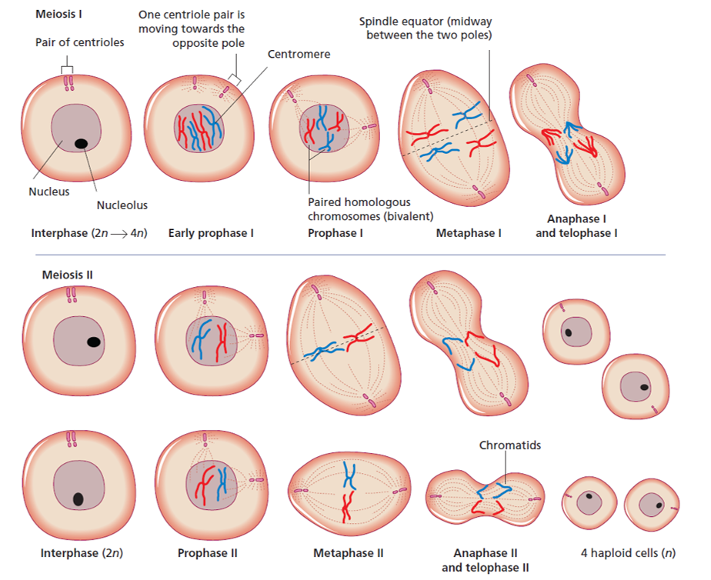
Meiosis
Cell division
Process by
which haploid
gametes are
formed.
Figure 1.24

Slide 36
Sex determination
Fertilisation
When fertilisation occurs, haploid gametes fuse to form a diploid zygote.
The heterosomes, or sex chromosomes, determine the sex of the zygote.
In humans, the female sex is determined by the presence of two X chromosomes, i.e. XX. Males are XY.
In some species, such as some insects, females are XX and males are XO, where O denotes the absence of a chromosome.
In other species, females develop from fertilised eggs and males develop from haploid gametes.
Sex determination can also be via environmental factors such as temperature.

Slide 37
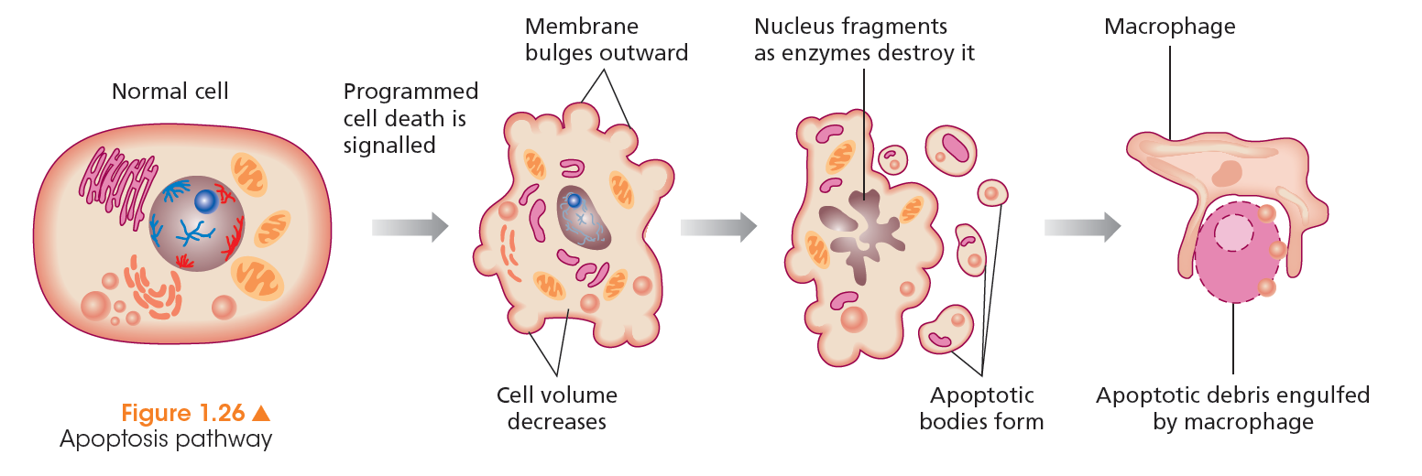
Death is a normal part of a cell’s life
Apoptosis
Apoptosis is the programmed, organised process of cell death.
It is a normal part of development and maintenance of an organism.
Failures in apoptosis are a major cause of cancer, in which cells survive and proliferate uncontrollably.

Slide 38
Chapter summary
DNA is the hereditary material
Structure of DNA
Organisation of DNA
Cell division
Fertilisation
Apoptosis

